Slide 1
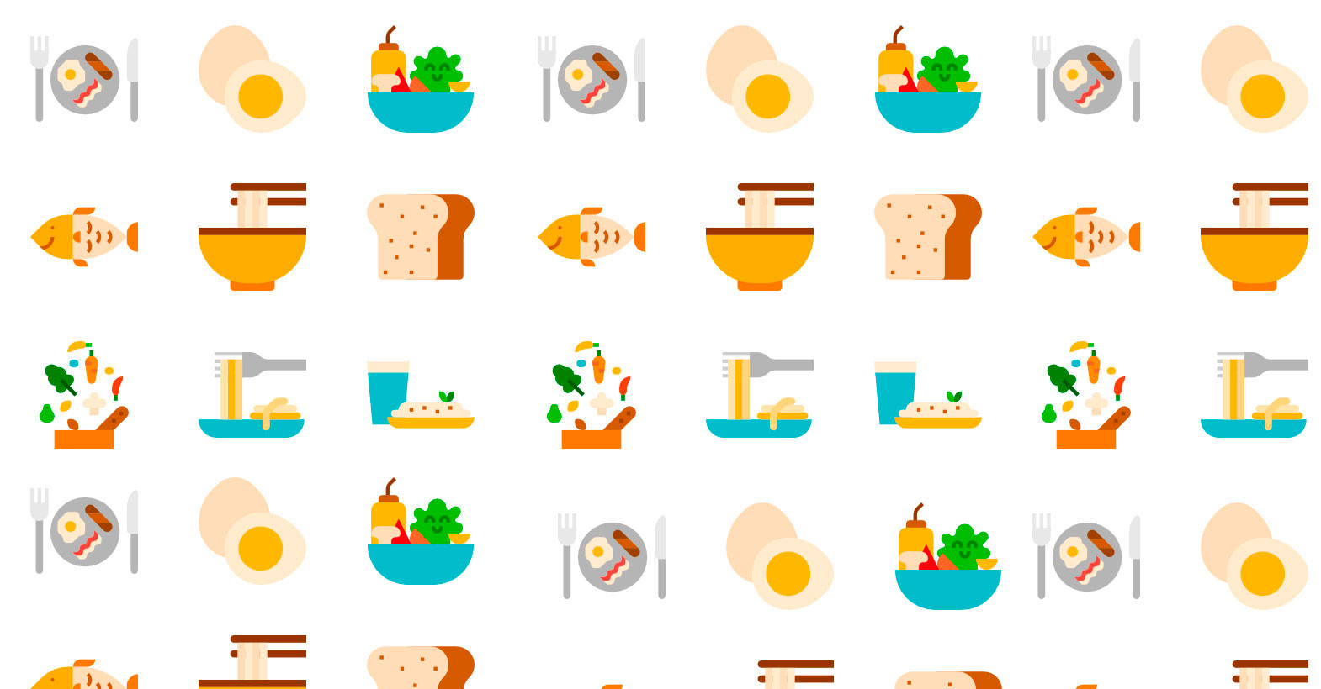

Cooking Mining
Sophie Kaltenleithner, Simone Sandler

Slide 2
Motivation Methods
Is it possible to represent recipes as processes?
What are the possible activities?
What are the key activities in some recipe type?
Natural language processing
Python
TreeTagger
NLTK
Analysis
Disco
BupaR
ProM

Slide 3
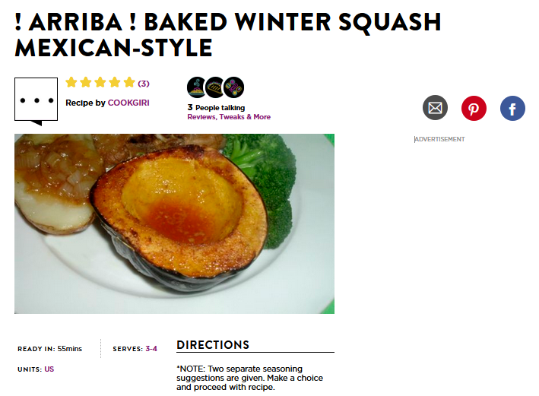

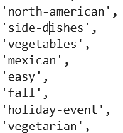
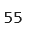
Dataset
Kaggle: Food.com Recipes and Interactions
Name:
Tags:
Total preparation time (minutes):

Slide 4
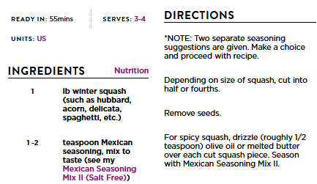
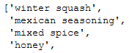
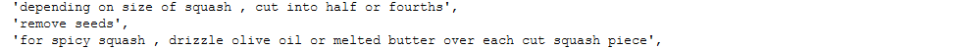
Dataset
Ingredients
Preparation Steps
Plain text
In order

Slide 5
Preprocessing: Ingredients
Two words: “chopped onions”
Only one in preparation step: “cook the onions in a little oil”
Split ingredient: “chopped”, “onions”
Nouns: “chopped”, “onions”
NN0 (neutral)
NN1 (singular),
NN2 (plural)
Stemming: “onions” → “onion”
time-to-make

Slide 6
Preprocessing: Steps
Find ingredients: “whisking eggs and milk in a bowl”
Tag other words: “whisking (VVG) eggs and (CJC) milk in (PRP) a (AT0) bowl (NN1)”
Extract actions (VVx): “whisking”
Stemming: “whisking” → “whisk”
Events: [“whisk”, “egg”], [“whisk”, “milk”]
Action and ingredient
Same timestamp

Slide 7
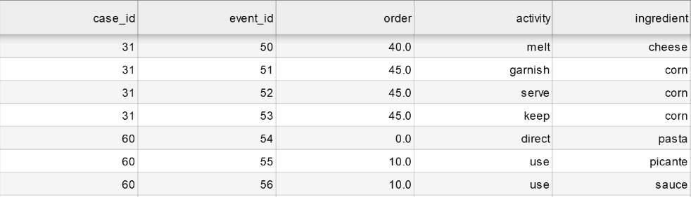
Preprocessing: Other
Time:
Total time: 55 min
Total steps: 10
Every step: 5.5 min
Remove when > 24h
Filtering:
Tags
Recipe Name
Max results

Slide 8
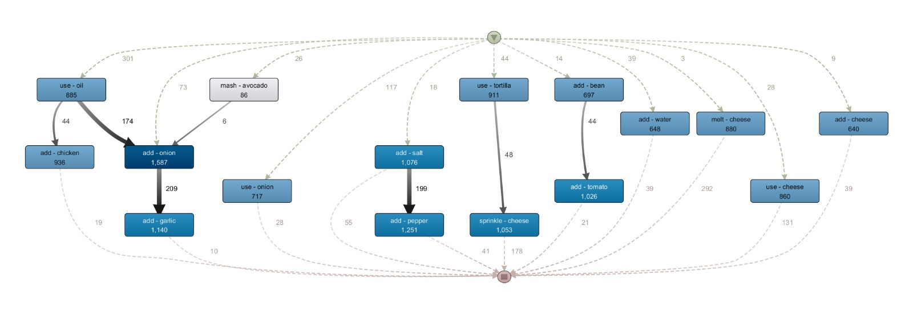
Filter: Tag – “Mexican”

Slide 9
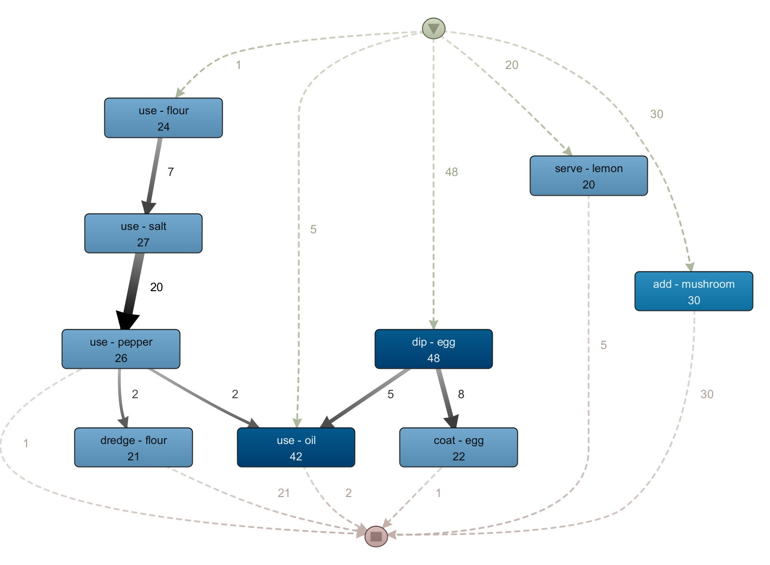
Filter: Name – “Schnitzel”

Slide 10
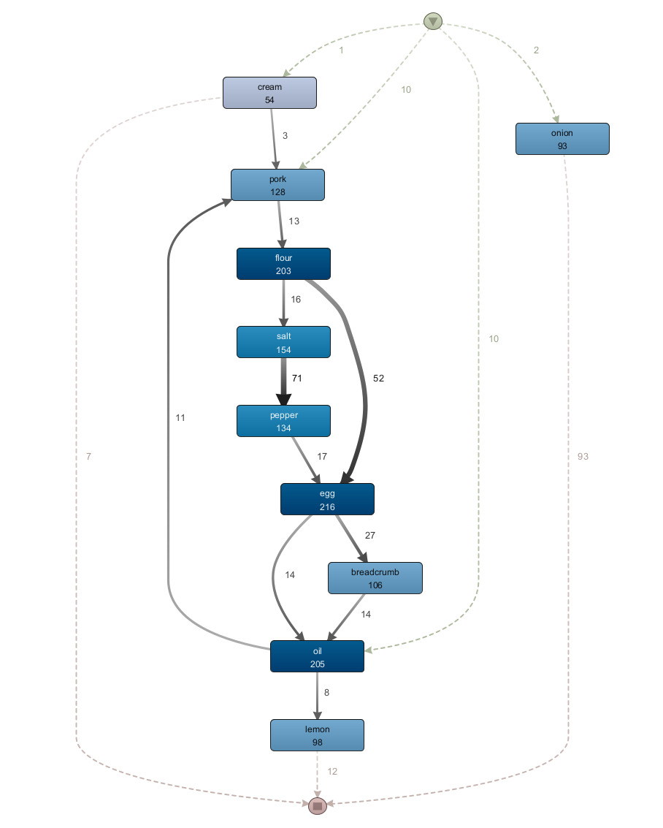
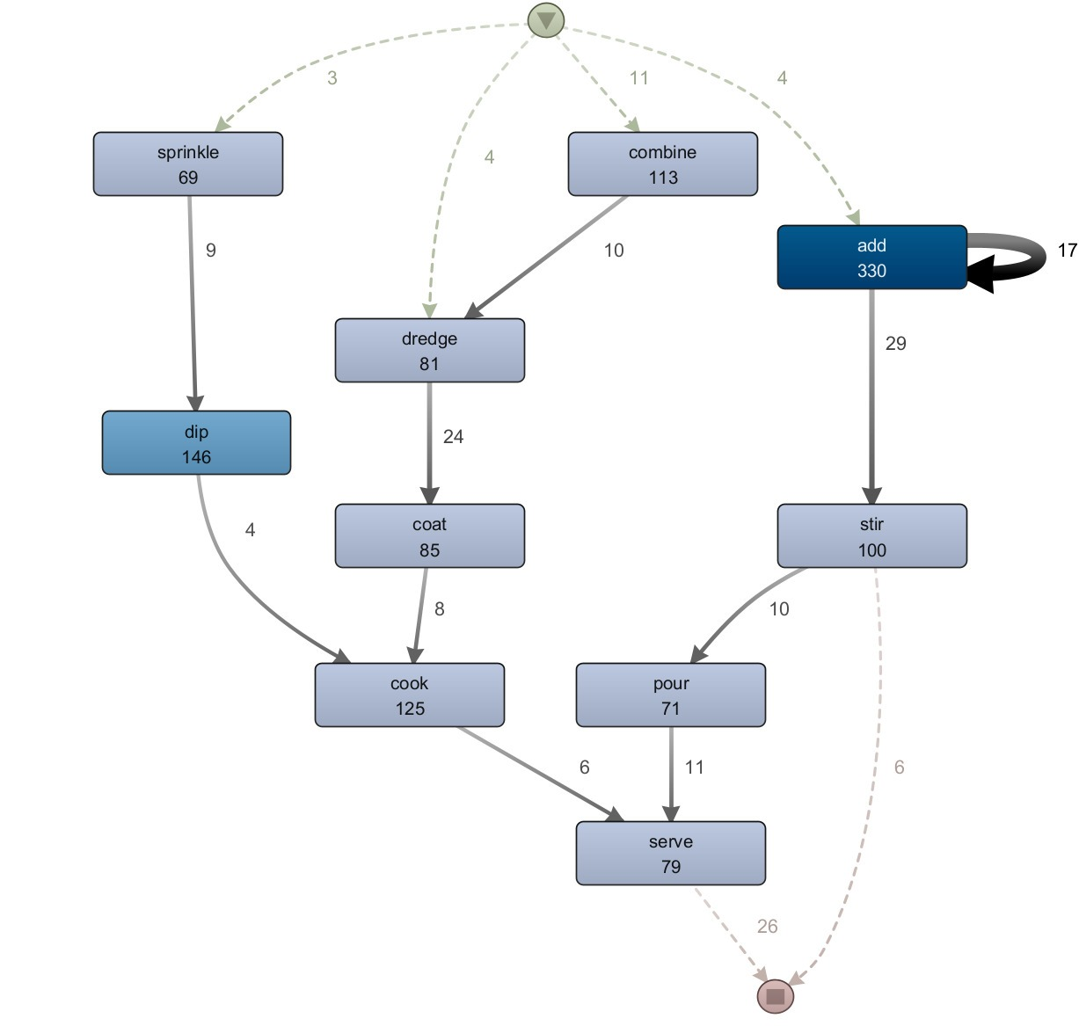
“Schnitzel” – Ingredient & Action Process

Slide 11
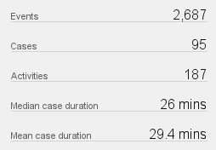
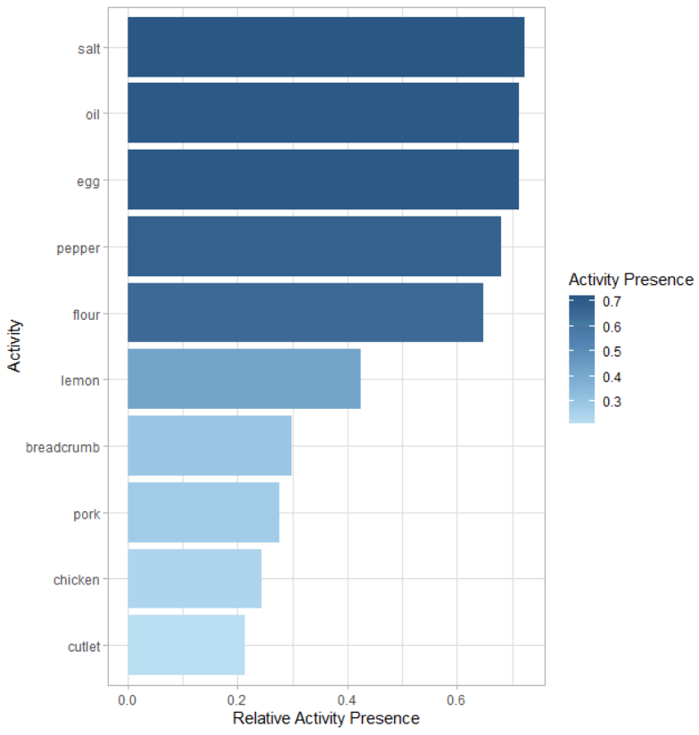
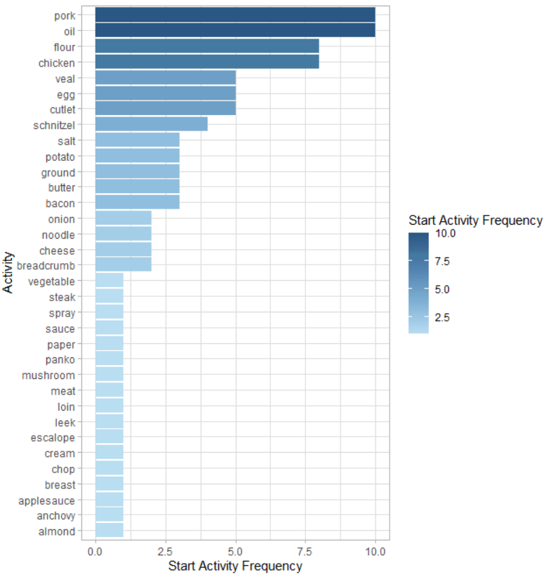
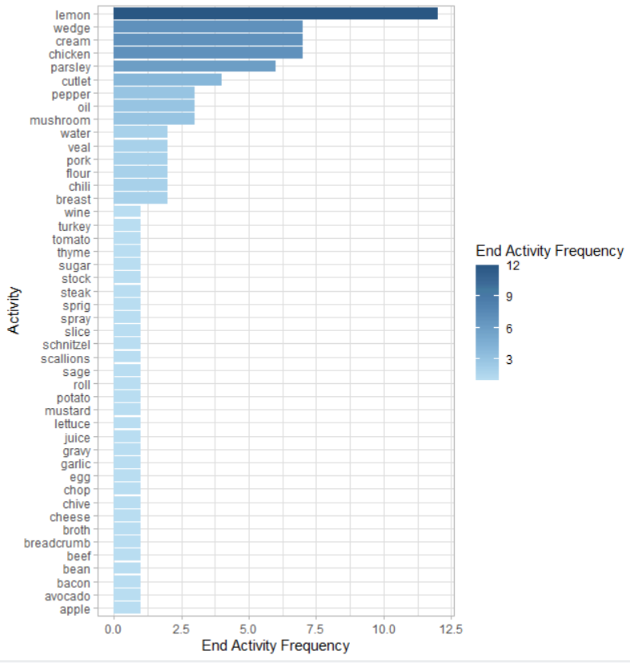
“Schnitzel” – Statistics

Slide 12
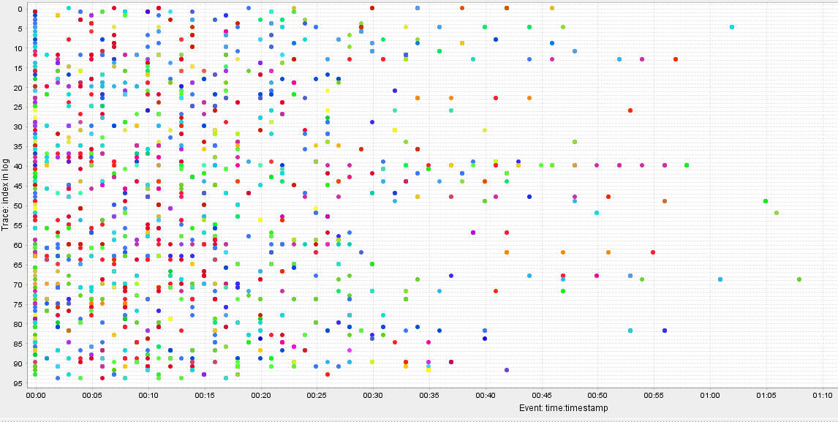
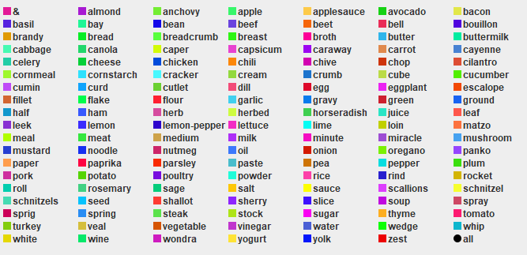
“Schnitzel” - Dotted Chart

Slide 13
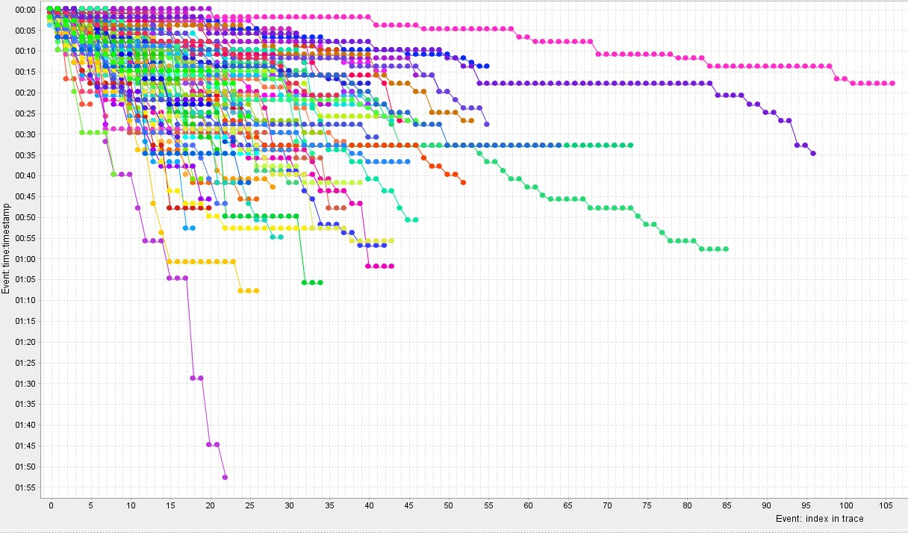
“Schnitzel” - Dotted Chart

Slide 14
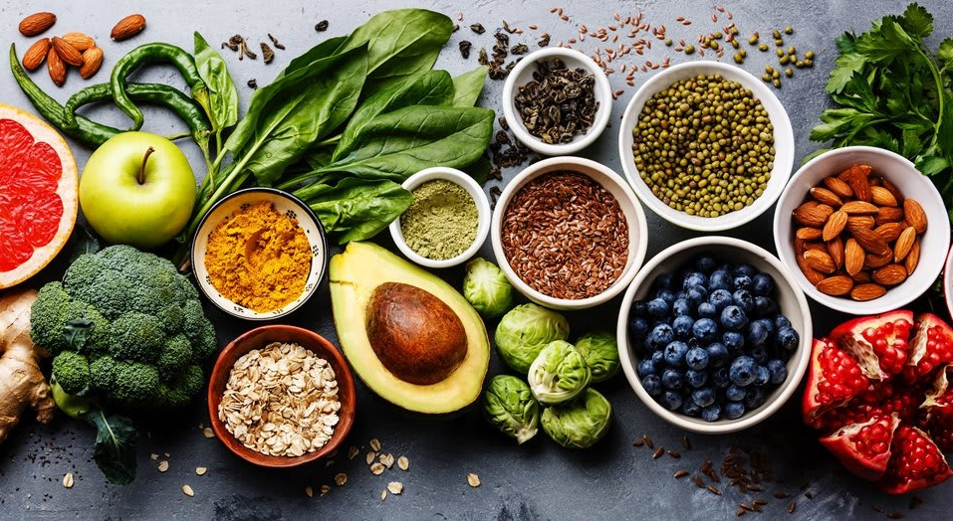
Quiz Time!

Slide 15
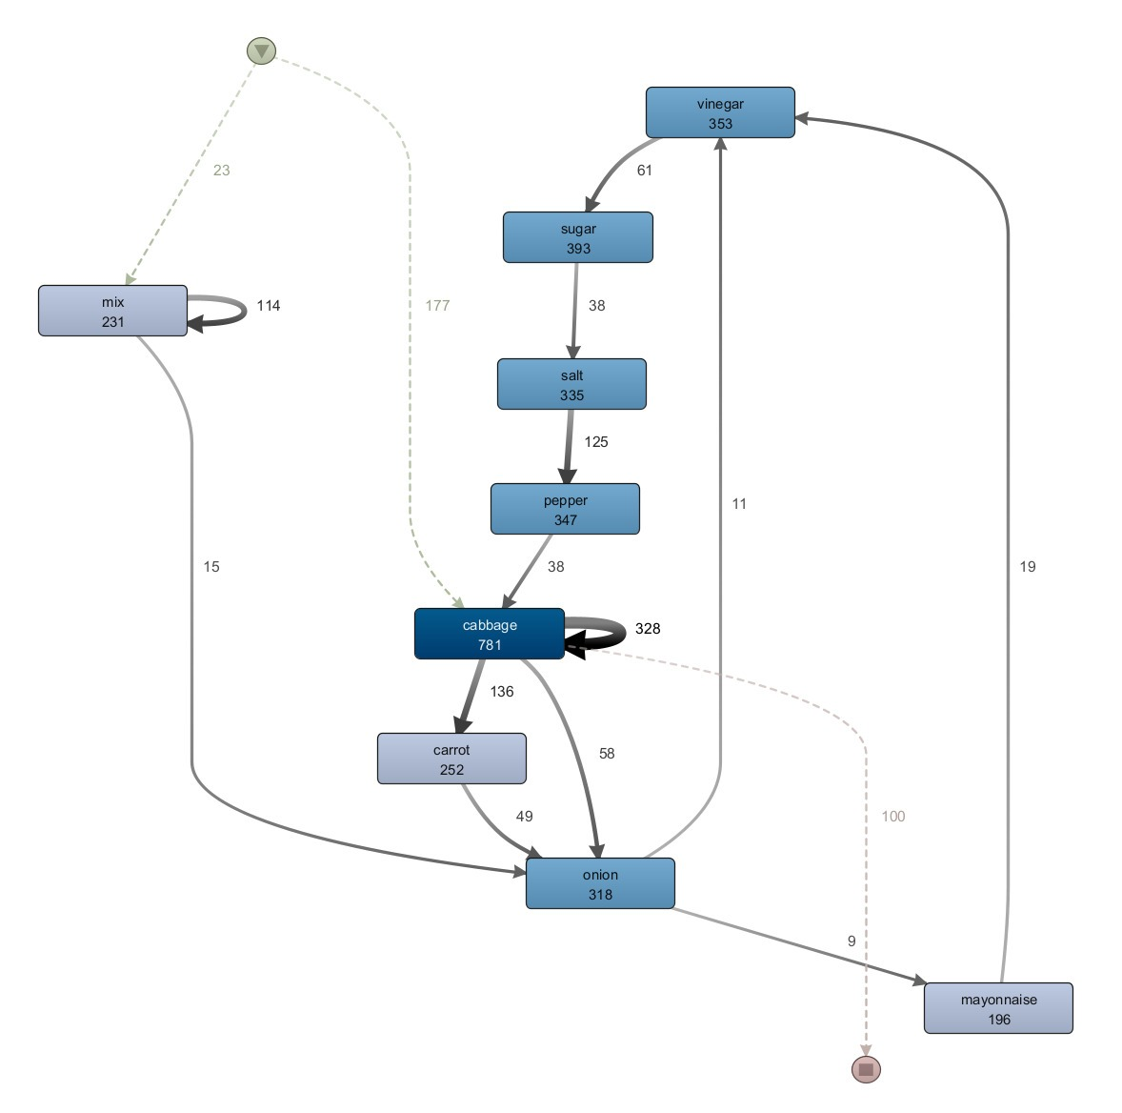
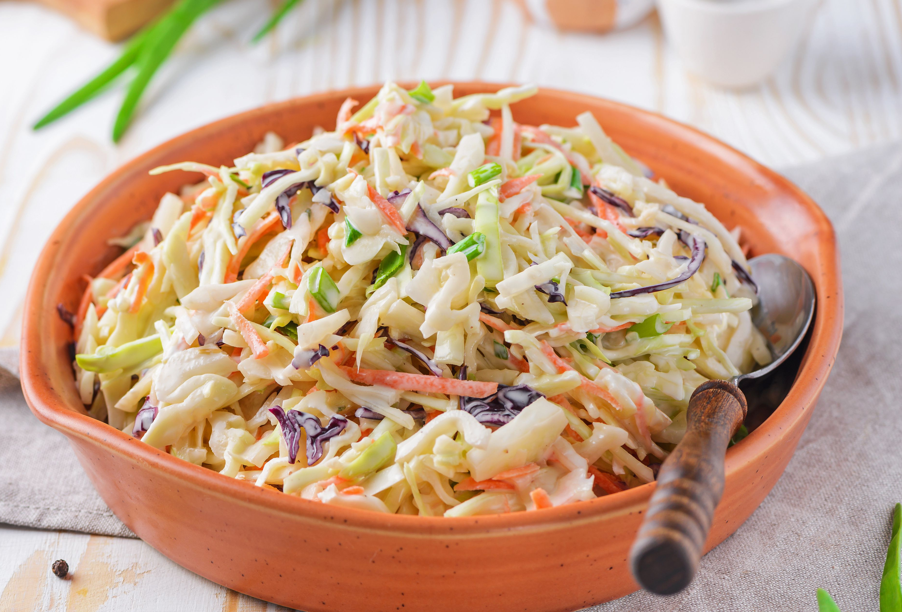

Slide 16
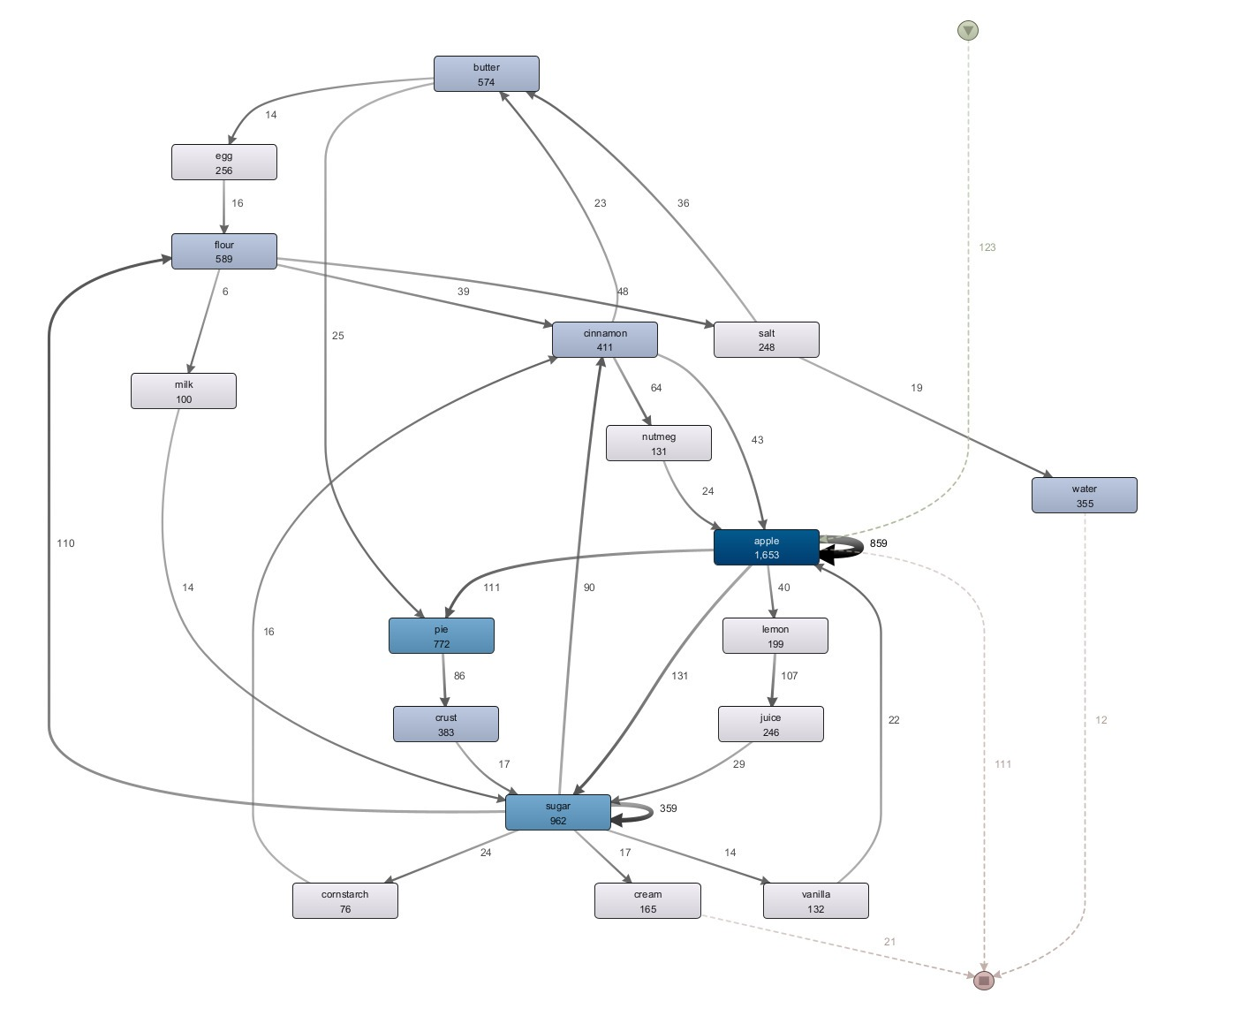
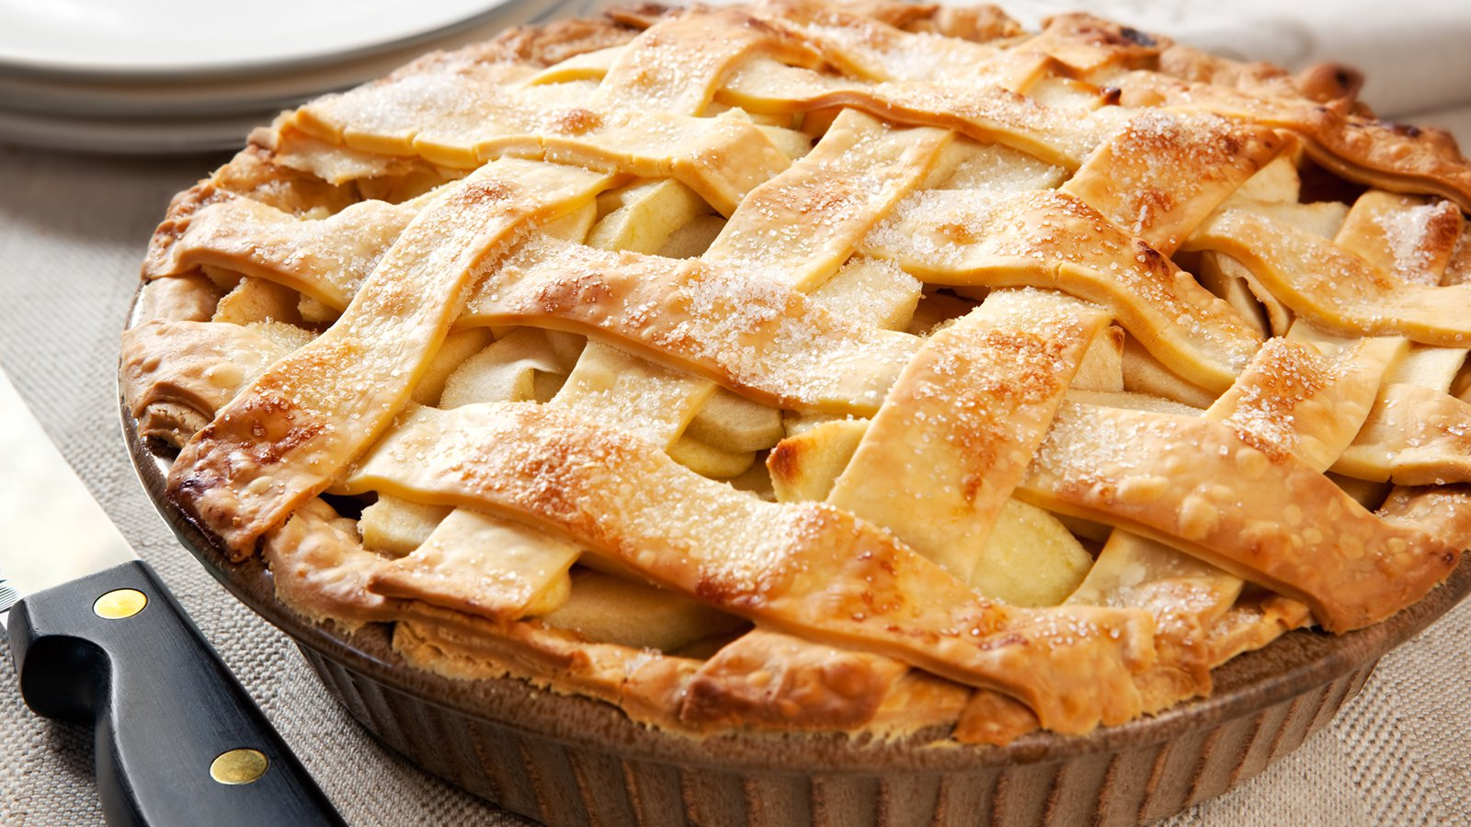

Slide 17
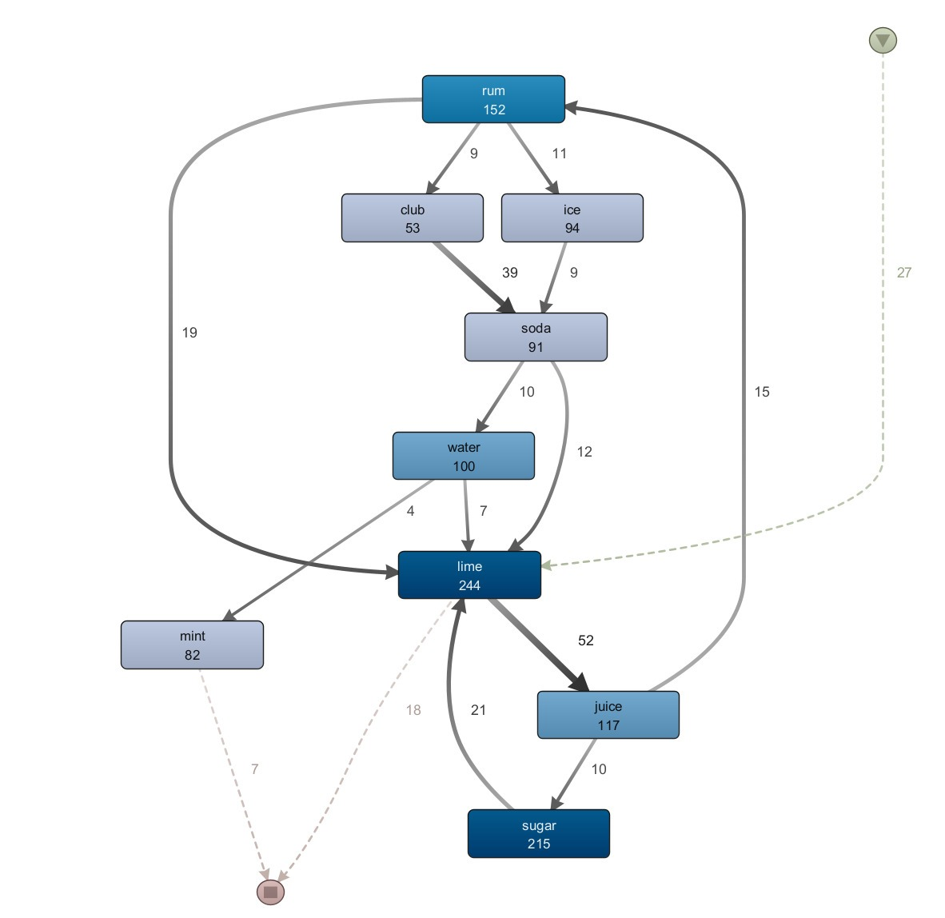
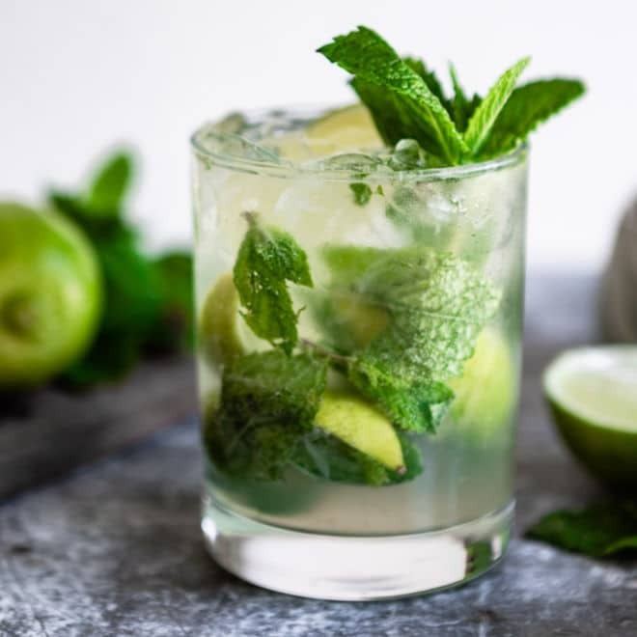

Slide 18
Results
Filter recipes
Tag
Name
Max results
CSV-Eventlog
General process
No “fancy” extras
When are which ingredients used?
When are which actions executed?
General statistics

Slide 19
Problem
Big variety of activities and and ingredients
Cluttered dotted charts
Possible Solution: Use of taxonomy
Apple → Fruit
Pear → Fruit
Slice → Cut
Cut → Cut

Slide 20
Questions?

